Slide 1
Von Neumann Architecture

Slide 2
Architecture
Architecture is the art and science of designing physical structures
Computer Architecture is the organization of the components making up a computer system and the semantics (meaning) of the operations that guide its function.
A computer system is composed of many parts, both hardware and software.

Slide 3
Von Neumann Architecture
The von Neumann architecture, also known as the von Neumann model or Princeton architecture, is a computer architecture based on a 1945 description by John von Neumann (Hungarian-American mathematician), and by others.
Von Neumann architecture is based on the stored-program computer concept, where instruction data and program data are stored in the same memory.
This architecture has these following components:

Slide 4
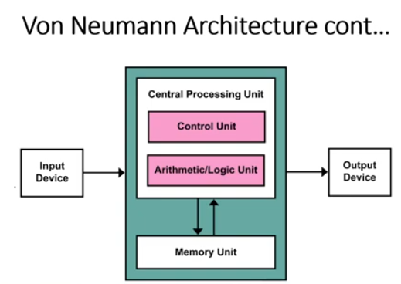

Slide 5
Von Neumann Architecture Components
CPU with ALU, CU, and registers.
Memory that stores data and instructions
Input and output mechanisms
External mass storage

Slide 6
Von Neumann Architecture Components
A Von Neumann-based computer:
Uses a single processor
Uses one memory for both instructions and data
Executes programs following the fetch-decode-execute cycle

Slide 7
Von Neumann Architecture Components - CPU
The part of the Computer that performs the bulk of data processing operations and responsible for executing the instructions of a computer program is called the Central Processing Unit.
The CPU performs a variety of functions dictated by the type of instructions that are incorporated in the computer.
The major components of CPU are ALU (Arithmetic and Logic Unit), CU (Control Unit), and a variety of registers.

Slide 8
Von Neumann Architecture Components – CPU (ALU)
The Arithmetic and Logic Unit (ALU) performs the required micro-operations for executing the instructions.
In simple words, ALU allows arithmetic (ad, subtract, etc) and logic (AND,OR,NOT etc) operations to be carried out.

Slide 9
Von Neumann Architecture Components – CPU (CU)
The Control Unit of a computer system controls the operations of components like ALU, memory and input/output devices.
The Control Unit consists of a program counter that contains the address of the instructions to be fetched and an instruction register into which instructions are fetched (stored) from memory for execution.

Slide 10
Von Neumann Architecture Components – CPU (Registers)
Registers refer to high-speed storage areas in the CPU
The data processed by the CPU are fetched from the registers.
Following is the list of registers that plays a crucial role in data processing.

Slide 11
Von Neumann Architecture Components – CPU (Registers)
Registers | Description
MAR (Memory Address Register) | This register holds the memory location of the data that needs to be accessed.
MDR (Memory Data Register) | This register holds the data that is being transferred to or from memory
AC (Accumulator) | This register holds the intermediate arithmetic and logic results
PC (Program Counter) | This register contains the address of the next instruction to be executed
CIR (Current Instruction Register) | This register contains the current instruction during processing

Slide 12
Von Neumann Architecture BUSES
Buses are the means by which information is shared between the registers in a multiple-register configuration system.
Von-Neumann Architecture comprised of three major bus systems for data transfer.

Slide 13
Von Neumann Architecture BUSES
Bus | Description
Address Bus | Address Bus carries the address of data (but not the data) between the processor and the memory
Data Bus | Data Bus carries data between the processor, the memory unit and the input/output devices.
Control Bus | Control Bus carries signals/commands from the CPU.

Slide 14
Von Neumann Architecture Memory Unit
A memory unit is a collection of storage cells together with associated circuits needed to transfer information in and out of the storage.
The memory stores binary information in groups of bits called words.
The internal structure of a memory unit is specified by the number of words it contains and the number of bits in each word.

Slide 15
Von Neumann Architecture Memory Unit
Two major types of memories are used in computer systems
RAM (Random Access Memory)
ROM (Read-Only Memory)

Slide 16
Introduction to Problem Solving

Slide 17
Definition of Problem
Any question or matter involving doubt, uncertainty, or difficulty
A problem is generally considered to be a task, a situation, or a person that is difficult to deal with or control due to complexity

Slide 18
Problem Solving
Problem-solving is the act of defining a problem; determining the cause of the problem; identifying, prioritizing, and selecting alternatives for a solution; and implementing a solution.
Finding a suitable solution for issues can be accomplished by following the basic five-step problem-solving process.
Problem Statement
Understand the problem (input, processing, output)
Generate alternative solutions
Evaluate and select an alternative
Implement and follow up on the solution

Slide 19
Example: Write a program that shows your first name in Uppercase and your last name in lowercase letters on screen.
Approach -1:
Hard code your name in the program
e.g. cout << “JOHN doe”;
Issue:
Program is not generalized (means; every time you need to change the values to print a new person’s name)
Approach -2:
Ask the user to enter his/her name
The program does the processing and gives you the output

Slide 20
#include <iostream>
#include <cctype> //for transform string into uppercase and lowercase
using namespace std;
int main(){
//variables
string firstName;
string lastName;
//ask the use to enter the first name
cout << "Enter your first name: ";
cin >> firstName;
cout << "Enter your last name: ";
cin >> lastName;

Slide 21
//Transform first name into uppercase
for(int i=0;i<firstName.length();i++)
{
firstName[i] = toupper(firstName[i]);
}
//Transform last name into lowercase
for(int i=0;i<lastName.length();i++)
{
lastName[i] = tolower(lastName[i]);
}
//Print the outputs on the console
cout << firstName << endl;
cout << lastName << endl;
}//end main

Slide 22
Example: Write a program that takes roll number, percentage of marks, and grade from the user as input. The Program should display the formatted output like the following.
Roll No : input value
Percentage : input value %
Grade : input value

